Slide 1
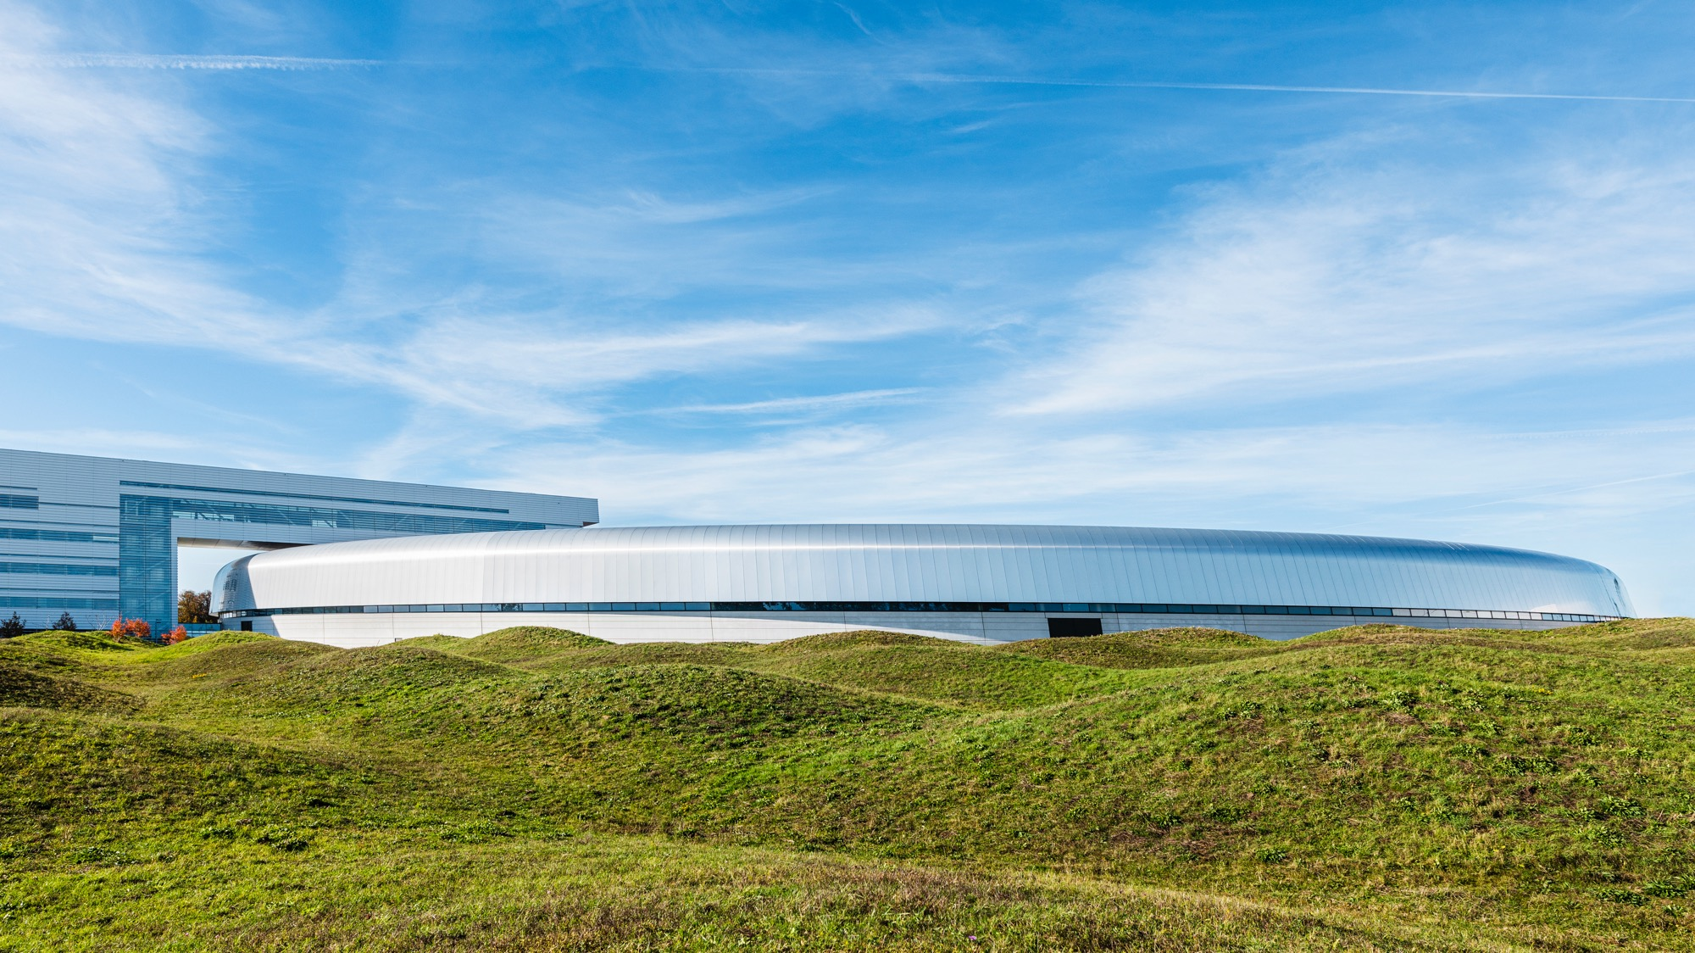
Welcome to Skåne
the southernmost part of Sweden
Photo: Apelöga

Slide 2
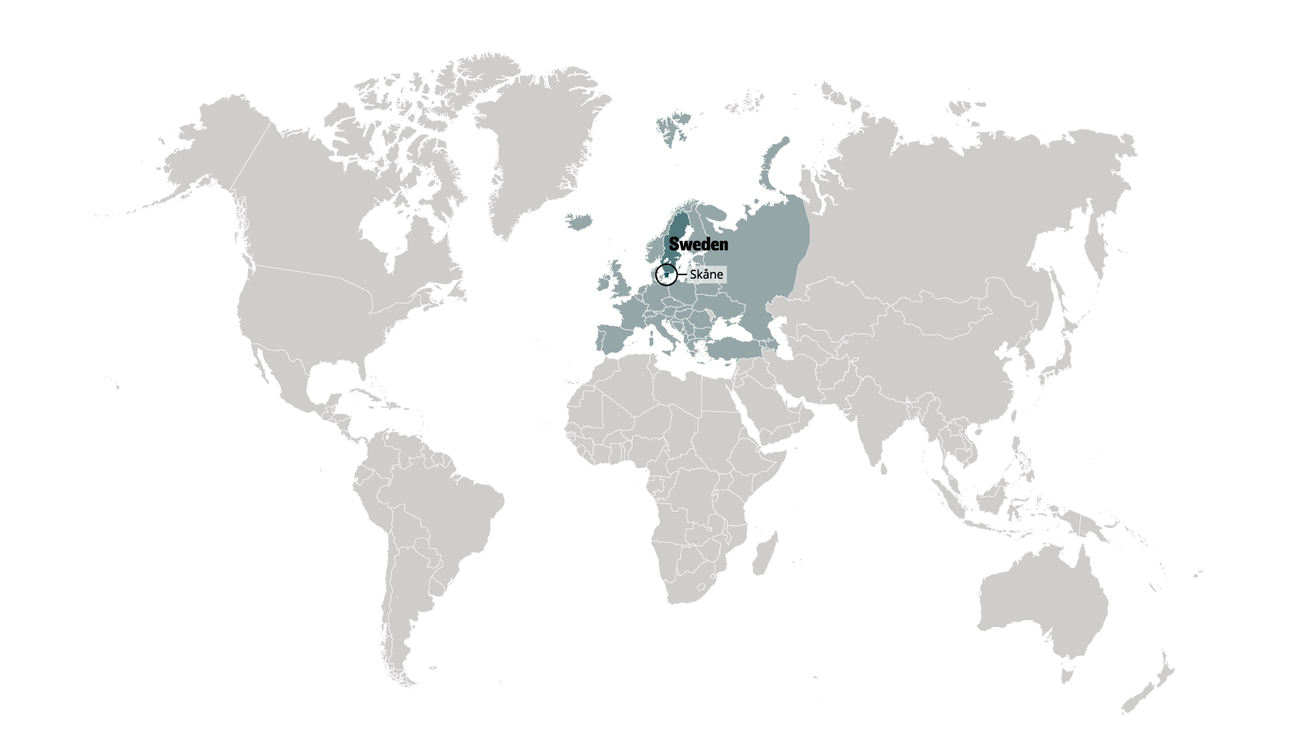
Skåne is situated at the heart of Scandinavia
The southernmost part of Sweden, Skåne is a region that’s in the centre of things with access to 4.4 million people in the Greater Copenhagen Region
Its unique geography makes it a point of connection between Denmark and Sweden through the Öresund Bridge
Notes:
Skåne is the southernmost region of Sweden, located at the heart of Scandinavia.
Its unique geography as part of Scandinavia and the Greater Copenhagen Region makes it a point of connection not just between Denmark and Sweden through the Öresund Bridge, but Europe and the Nordic region as well.
With 1.4 million people, Skåne is one of the largest labour markets in all of the Nordic countries.

Slide 3
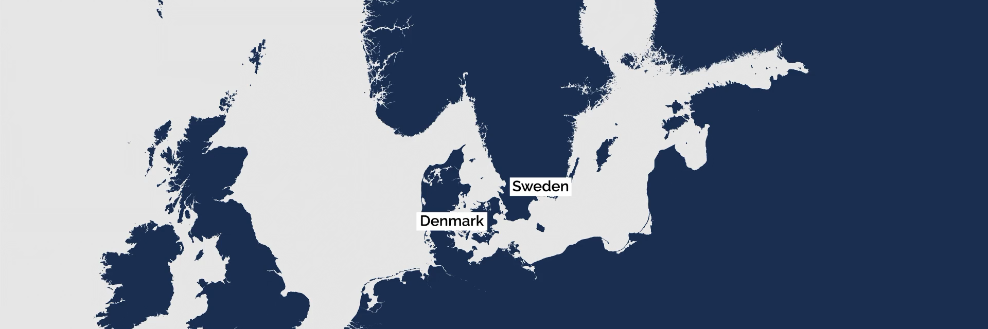
Skåne is part of the Greater Copenhagen Region
A political cross-border collaboration
Greater Copenhagen Region is the international brand for the geographical area covered by the regions Skåne and Halland in Sweden, as well as The Capital Region of Copenhagen and Region Zealand in Denmark.
Greater Copenhagen is the business policy partnership between 79 municipalities, 3 regions and 2 municipal councils and 1 municipal federation in the geographical area.

Slide 4
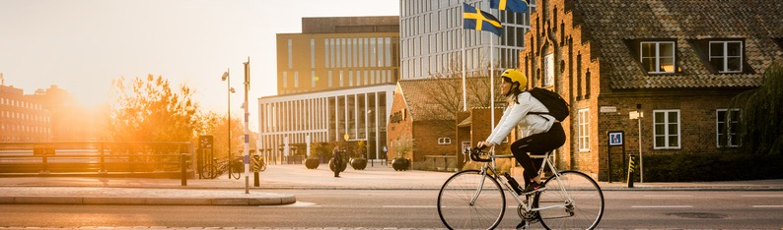
Small but important
27
million
10
million
4.4
million
1.4
million
Living in
the Nordics
Living in
Greater Copenhagen Region
Living in
Sweden
Living in
Skåne
Notes:
Skåne is a small but an important part of the world

Slide 5

This is Sweden
A country with some of the world´s
highest living standards
An open society built on stability and trust
Among the lowest corruption rates in the world
Excellent education system
2nd in the world for English skills out of all non-native English speaking countries in 2019
Some of the world´s best social benefits with subsidised healthcare, kindergartens and schools (including IB schools)
Minimum 5 weeks paid annual vacation
Notes:
Some of the world´s best social benefits with subsidised healthcare, kindergartens and schools
(EF English Proficiency Index 2019)
https://www.transparency.org/en/countries/Sweden

Slide 6
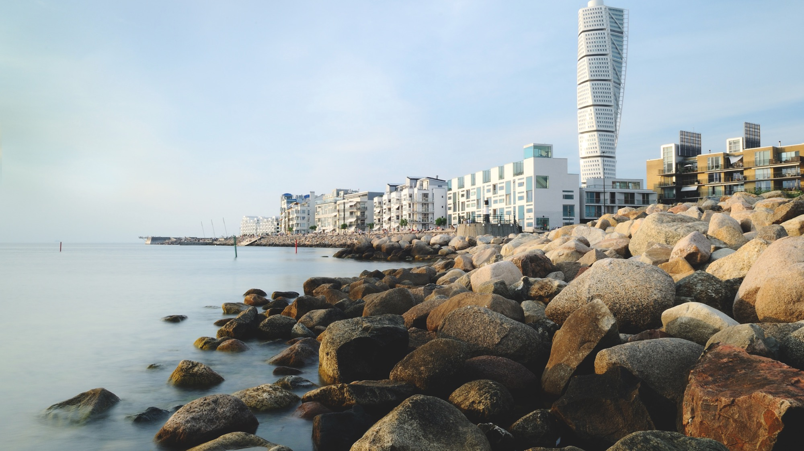
An excellent place for doing business
EU
Innovation
Scoreboard 2021
WIPO
Global Innovation
Index 2020
IMD
World Talent
Ranking 2021
Forbes
Best countries for
Business 2018
Network
Readiness Index
2020
European Capital
of Innovation,
iCapital award 2020
Sweden
Finland
Denmark
Belgium
Netherlands
Switzerland
Sweden
USA
UK
Netherlands
Switzerland
Sweden
Luxemburg
Norway
UK
Sweden
Hong Kong
Netherlands
New Zealand
Sweden
Denmark
Singapore
Netherlands
Switzerland
Leuven, Belgium
Helsingborg, Sweden
Vienna, Austria
Valéncia, Spain
Espoo, Finland
Cluj- Napoca, Romania
Notes:
Sweden is positioned in the very top in various business environment rankings.
Sweden as a whole was ranked first in the 2021 EU Innovation Scoreboard and second in the 2020 WIPO Global Innovation Index.
According to Forbes 2018 list Best Countries to do business, Sweden was ranked second¨¨. Forbes rated 161 nations on different factors such as: property rights, innovation, taxes, technology, corruption, infrastructure, political risk and quality of life.
Sweden is the most future-ready country according to the Network Readiness index 2020.The Index is grounded in four fundamental dimensions: Technology, People, Gov-ernance and Impact. It covers issues ranging from future technologies such as Artificial Intelligence (AI) and the Internet of Things (IoT) to the role of the digital economy in reaching the Sustainable Development Goals (SDGs).
The city of Helsingborg came second in the 2020 iCapital award issued by the EU. The city launched its H22 initiative in 2019 which aims to transform Helsingborg into a smarter and sustainable city that puts its residents and the planet first to improve quality of life.1

Slide 7
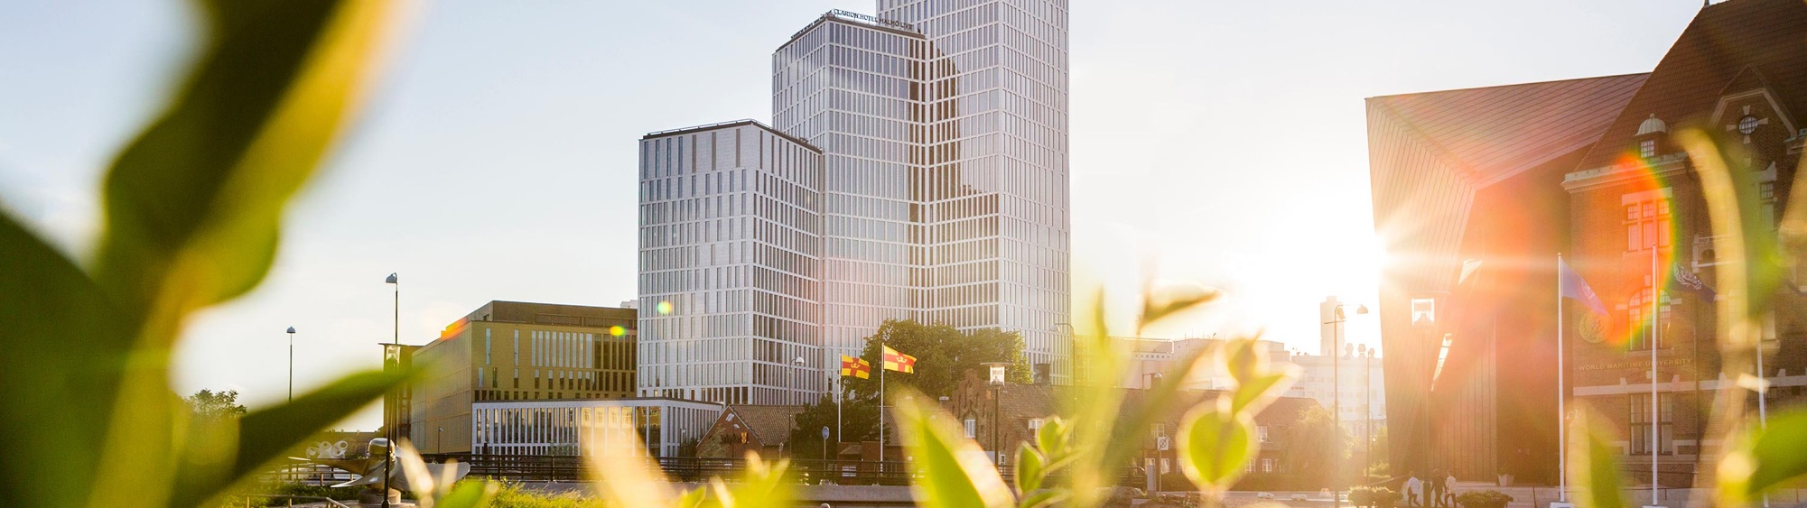





Skåne’s strengths and position
A strategic
location
Access to
highly skilled people
An innovation
leader
A collaborative ecosystem
Exceptional quality
of life
Notes:
An innovation leader
Skåne often ranks high in global indices of the world’s most innovative regions. Skåne is home to world-leading technology companies, well-known start-up companies, and ground-breaking research. Skåne has a long history of innovation and the region’s prosperity is based on innovative and successful export companies that have been able to adapt as the market changes.
A quadruple helix ecosystem
As part of the Greater Copenhagen metropolitan region, as well as the Medicon Valley life science cluster, Skåne is located in one of the most knowledge-intensive areas in all of the Nordic countries. That extensive expertise is harnessed for collaboration via Sweden’s fostering of the quadruple helix model of innovation in public policy, which creates touch points between academia, industry, government, and civil society, thus enabling for efficient economic and social development.

Slide 8
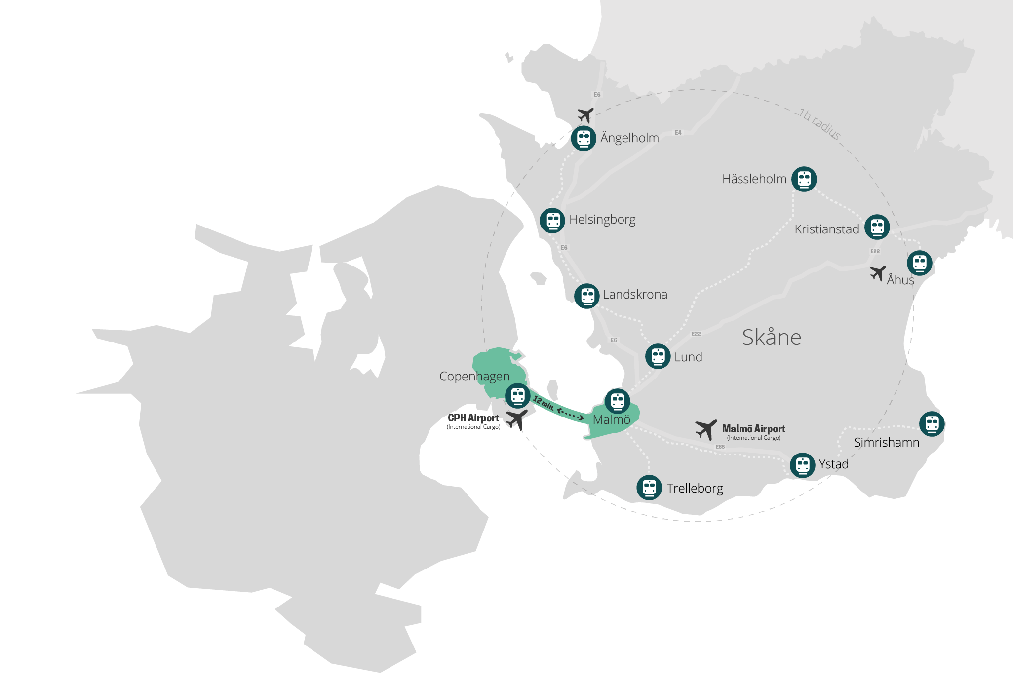
Everything you need within one hour by car or public transport
The largest international airport in the Nordics, Copenhagen International Airport (CPH) is located within 20 minutes by train or car from the city of Malmö
Most of the region is reachable within one hour by car or train
Skåne is also a key point of access to both the 25 million consumers in Scandinavia and the 125 million in Northern Europe
Notes:
Skåne is where Sweden meets Denmark and Scandinavia meets the world. The proximity to Copenhagen, with a major international airport and a potentially large labour market on the other side of the strait, presents great opportunities. Copenhagen Airport is the largest in Scandinavia and transports passengers and cargo to around 165 destinations every year.
Most of the region is reachable within one hour by car or train
On its own, the region is part of a dynamic transnational market of over 4 million consumers; but it’s also an essential link between the 25 million consumers in Scandinavia and the 125 million in Northern Europe.

Slide 9

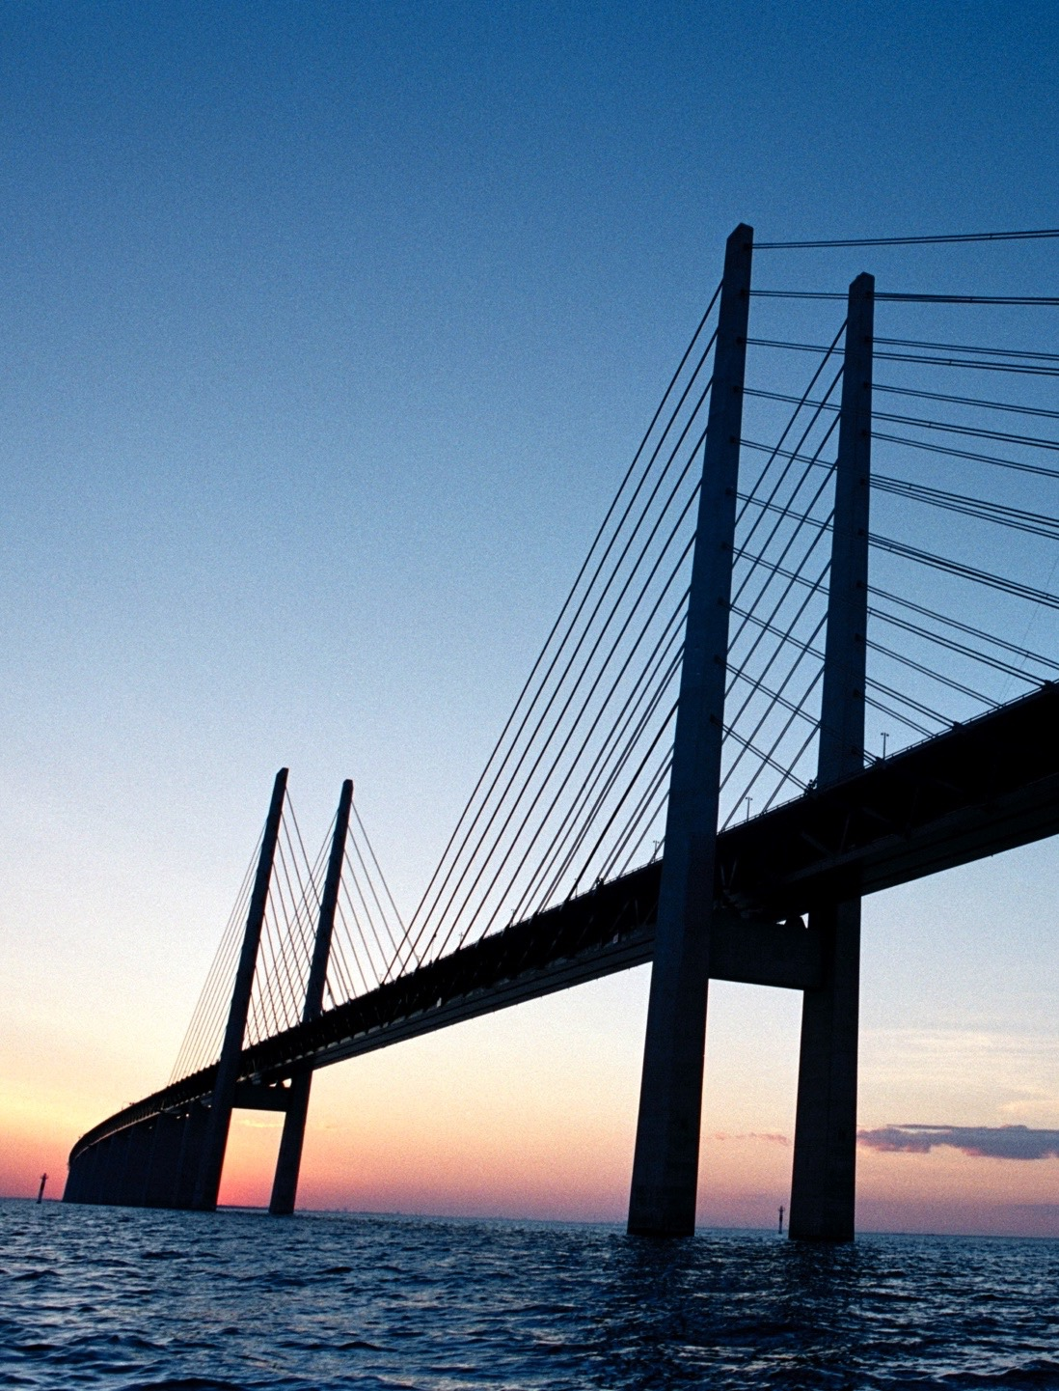
The iconic Öresund Bridge
Photo: Lasse Davidsson
Photo: Carolina Romare
Notes:
Connecting Copenhagen to Skåne, is the Öresund bridge, the longest combined road and rail bridge in Europe. Completed in 2000, it connects two countries and cultures – it’s not just a bridge, it is The Bridge. The crime drama is set in the Malmö-Copenhagen area and is named after the Öresund bridge. Since it was first aired in 2011, the Swedish/Danish TV series has been rolled out in 134 countries.
The bridge was finalized in 2000, and paved way to an integration between Denmark and Sweden and it serves as a catalyst for further development, and a physical starting point for change. It’s a vision that after some 100 years, became a reality.
As a construction project the Öresund bridge was a best practice case, not only because the project was finalized according to budget and on time, but it was also a best practice environmentally. The bridge has served as a political and economic motor for both countries.
Approximately 60’ 000 people commute between the countries every year via this famous bridge. (source:orestat).

Slide 10
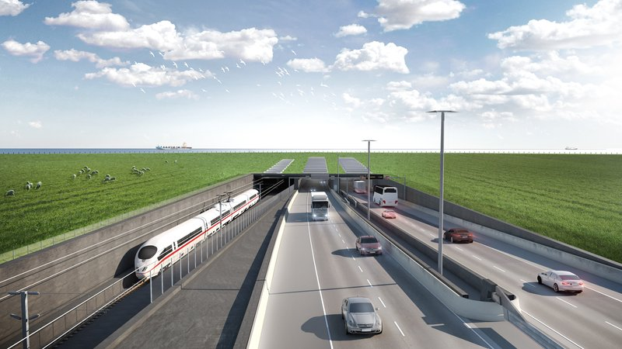
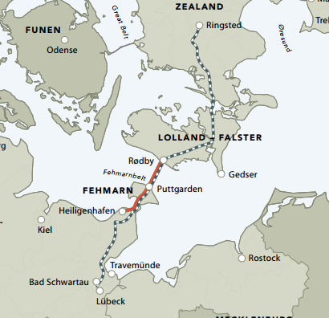
The Fehmarn Belt tunnel in 2028
Photo: Femern A/S
Notes:
The Fehmarn Belt link, a tunnel between Rödby in Denmark and Puttgarten in Germany, is expected to be operational by 2028. It will provide swift access to Germany and other European markets.
Once completed, the journey between Denmark and Germany will take 7 minutes by train and 10 minutes by car.
That means you will be able to travel from Stockholm to Hamburg in just nine hours and from Malmö to Hamburg in approx. three hours.
Yet another major infrastructure investment dawning, a link that will bring Scandinavia closer to the continent, Germany and the rest of Europe: the Fehmarn Belt Link.
This will be the longest combined rail and road tunnel, consisting of a four lane motorway alongside railway, as an immersed tunnel.
Facts
A fixed link, approx. 18 km long, between Fehmarn (DE) and Lolland (DK).
The Fehmarn region includes the important commerce center, Hamburg.
Construction period (prel.): 2015-24
Total costs: 5.5 billion EUR out of which 4.1 for construction

Slide 11
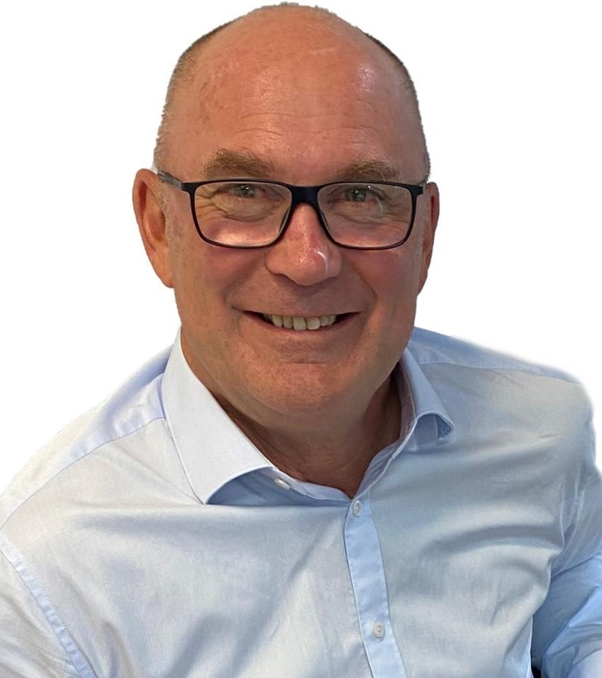
Quote
”Malmö is the ideal position for our business given the easy access to Kastrup, Europe and Scandinavia, where we are expecting the majority of our business.
I appreciate the ease of access to CPH. It makes life very easy for us. One stop from Melbourne to Malmö by plane.”
Garry Warren, Managing Director of ARRB Systems

Slide 12

Skåne is an innovation leader
The 2021 ‘Regional Innovation Scoreboard’ ranked Skåne overall as the 9th most innovative region in the EU
The region is home to world-leading technology companies, well-known start-up companies, and ground-breaking research.
Notes:
Skåne often ranks high in global indices of the world’s most innovative regions, 2021 ranked as 9th most innovative region in the EU
https://ec.europa.eu/growth/industry/policy/innovation/regional_en
Skåne is considered as the 2nd best region in EU when measuring ‘Lifelong learning’. Lifelong learning encompasses all purposeful learning activity, whether formal, non-formal or informal, undertaken on an ongoing basis with the aim of improving knowledge, skills and competence.
Skåne is also ranked as #2 region in EU when it comes to ‘PCT patent applications per billion regional GDP’. The indicator measures the number of patents applied for at the European Patent Office (EPO), by year of filing.
Skåne has a long history of innovation and the region’s prosperity is based on innovative and successful export companies that have been able to adapt as the market changes.

Slide 13









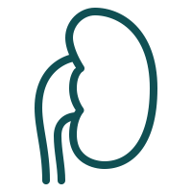


Made in
Skåne
1967
1994
2012
Endodrill
Instrument for cancer
diagnostics
Leo
Nicorette gum to quit smoking
1987
Qlikview
Software for data visualisation
Orbital systems World’s most water-efficient shower
1944
Dracos
Inhalator for asthma medicine
2013
1953
Tetra Pak
The first milk carton
Lund University
Medical
ultrasound
1994
2005
1946
Ericsson
Blue tooth technology
Hövding
The invisible helmet
1993
2004
Gambro
The artificial kidney
Oatly
Oat drink
Polar Rose
Facial recognition technology
Notes:
Here’s a list of just some of the inventions and innovations that come from Skåne, including the first portable phone, which was developed by Ericsson in Lund back in 1985; ultrasound diagnostics, researched and developed at Lund University; and the first milk carton, invented by Tetra Pak.
The Ultrasound Diagnostics: Having developed a technique for ultrasound diagnostics of the heart, a German physicist and a Swedish cardiologist at Lund University were the first to actually see the heart beat.
Kidney Dialysis Equipment: Skåne is the birthplace of the first practical device for kidney dialysis. Professor Nils Alwall's invention, developed by Gambro, has literally saved thousands of lives all over the world.
The first portable phone: The first ever portable analogue handset was developed at Ericsson in Lund in 1985.
The first milk carton: The first milk carton was invented and produced in Skåne by Tetra Pak. An idea that has had an enormous impact globally, helping to “protect what’s good”. Today the company is the leading food processing and packaging solutions provider.
Bluetooth Technology: The Bluetooth technology was also invented in Skåne by a team led by the engineer Sven Mathissen. At the time he was reading a novel about a Viking king called Harald Blåtand (translates to Bluetooth). The logo includes Harald’s initials in a Viking bind rune.
Proviva – In the early 1990’s the healthy bacteria culture Lactobacillus plantarum 299v was used and launched in the fruit drink ProViva.
Hövding – the invisible helmet

Slide 14
Also from Skåne...
Zlatan Ibrahimović
Absolut Vodka
Ubisoft’s
The Division
The Sounds
Crisp Rolls
Marie Fredriksson
Notes:
Well we all know who Zlatan Ibrahimović is, but did you know that Ubisoft´s The Division was developed here? Or the rockband The Sounds was born in Helsingborg? What about Absolut Vodka, well that is a Skåne baby to, along with he devlishius Crisp Rolls from Pågen. Marie Fredriksson, former singer in Roxette will always be a Skåne star.

Slide 15
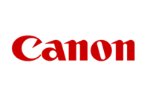
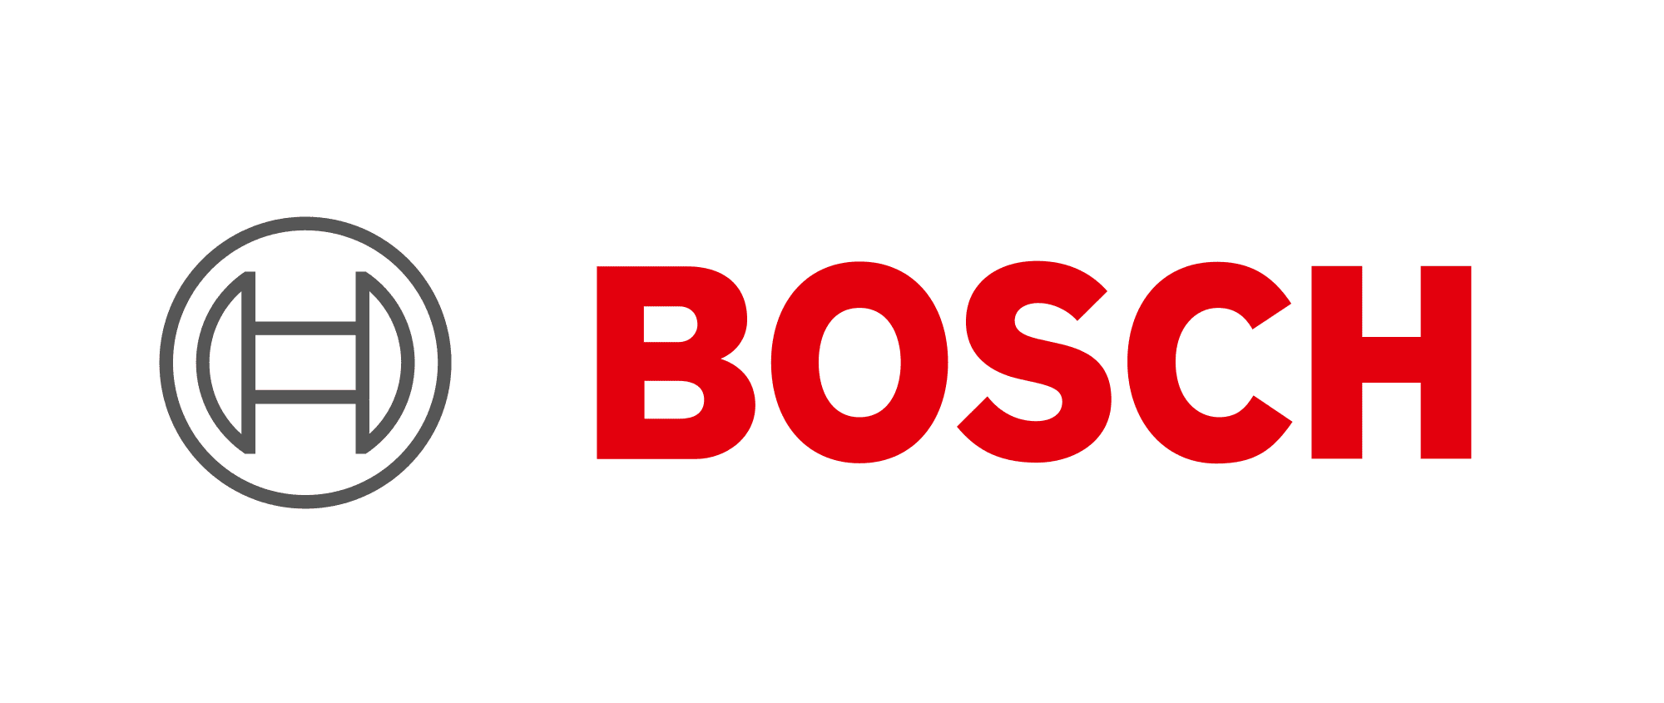








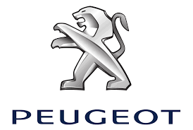










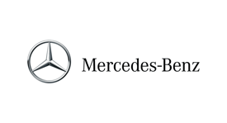









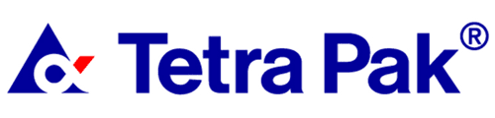

Examples of global HQ or R&D based in Skåne​
​

Slide 16









The innovation support system​
Krinova​
Ideon has 35+ years of history of supporting growing companies. Today the park is home to over 400 companies.
www.ideon.se
Catalyst for development and innovation in society. Sweden's largest and first incubator and science park with food as
a profile area.
www.krinova.se
Science park for companies within life sciences. Offers network, office and support in business development.
www.medeon.se
A collaboration-oriented member organisation and co-working space that integrates research, innovation and industry under one roof.
www.mediconvillage.se
SCIENCE AND
TECHNICAL PARKS
Guide and develop new opportunities for innovation and growth that improve Skåne as well as the world.
www.innovationskane.com
LU Innovation is a hub for innovation and commercialisation and the Tech Transfer Office at Lund University.
www.innovation.lu.se
Helps start-ups with global ambitions. Offers coaching and advice in business development, fundraising, marketing and team building.
www.minc.se
Non-profit business incubator for life science startups. Offering coaching programs, well-equipped labs and network.
www.smileincubator.life
INCUBATORS, ACCELERATORS AND INNOVATION SUPPORT
Notes:
In Skåne, there is a strong system that supports companies and entrepreneurs to develop and commercialise ideas for innovations, and runs various forms of development and innovation projects. Key players in this system are universities, research and technology parks, incubators and accelerators, research institutes, and cluster organizations, and in some cases municipalities.
Source: FIRS

Slide 17
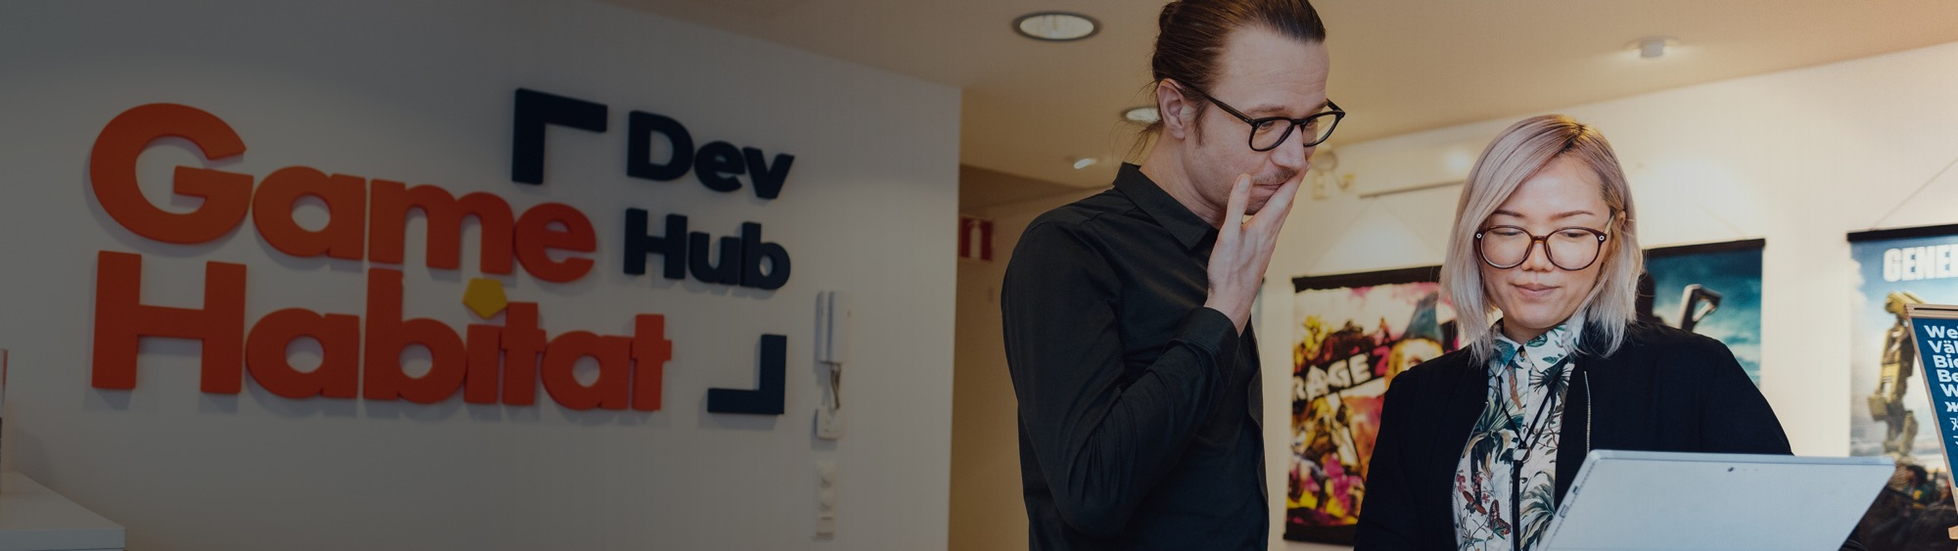








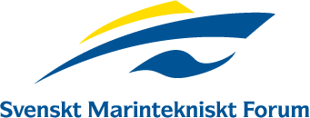
Cluster organisations in Skåne​
A non-profit membership organisation in the Danish- Swedish life science cluster Medicon Valley. The +250 members represent the
region's triple helix.
www.mva.org
A non-profit ICT cluster
organisation and networking
community promoting innovation and growth in the digital world
by connecting business, academia
and society.
www.mobileheights.org
A non-profit member
organisation with the mission to foster growth and innovation in the digital/creative industries of
southern Sweden.
www.mediaevolution.se
A neutral, non-profit cluster initiative/member
organisation for the entire
packaging ecosystem and a part of the Swedish
innovation system.​
www.packbridge.se
A cluster organisation in southern Sweden with a focus on smart sustainable cities.​
www.sbhub.se
A non-profit member
organisation for industrial
companies in Skåne.​
www.iucsyd.se
A non-profit organisation based in Malmö. Creates and developes a thriving, supportive and inclusive ecosystem for game development in southern Sweden.
www.gamehabitat.se​
A non-profit association for the food sector with the
aim to create an innovative,
competitive and long term
sustainable food industry​.
www.livsmedelsakademin.com
Together with their members they create possibilities for growth
and development for contractors
to shipping, offshore and the
leisure boat industry.​
www.smtf.se
Notes:
The cluster organisations in Skåne work to develop Skåne's innovative power under the name of Clusters of Skåne. Together they represent more than 1000 companies in Skåne. In 2020 these cluster organisations have formed a collaboration with the aim of jointly realising the goals in Skåne's Innovation Strategy, developed by the Research and Innovation Council in Skåne.
Source: FIRS

Slide 18
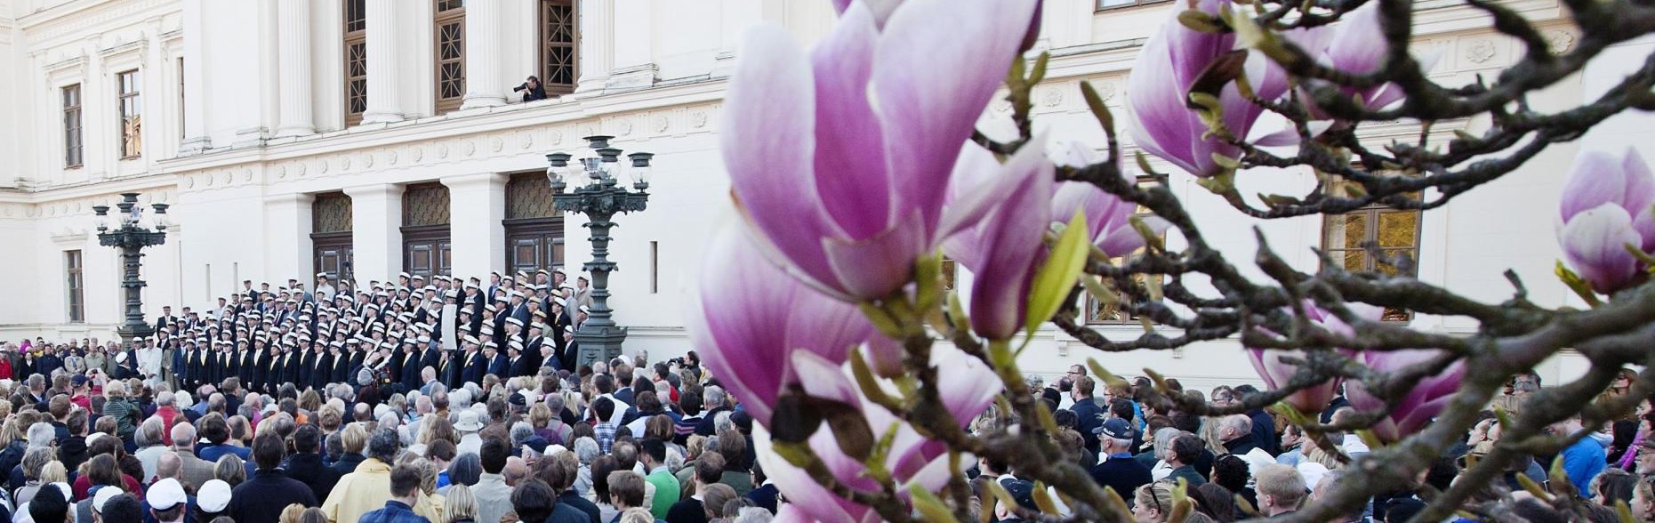
Universities and institutions
@ Apelöga
The Greater Copenhagen metropolitan region is home to
17 universities, including Lund University, the highest ranking academic institution in Sweden and among the top 100 universities in the world. Skåne is also home to Malmö University, the ninth largest institution of learning in Sweden, as well as Kristianstad University, Swedish University of Agricultural Sciences (SLU) and World Maritime University.
Notes:
The Greater Copenhagen region is home to 17 universities, including Lund University – the highest ranking academic institution in Sweden and among the top 100 universities in the world (Source: QS World University Rankings) and Malmö University, the ninth largest institutionof learning in Sweden. Furthermore Skåne is home to Kristianstad University, Swedish University of Agricultural Sciences (SLU) and World Maritime University.

Slide 19
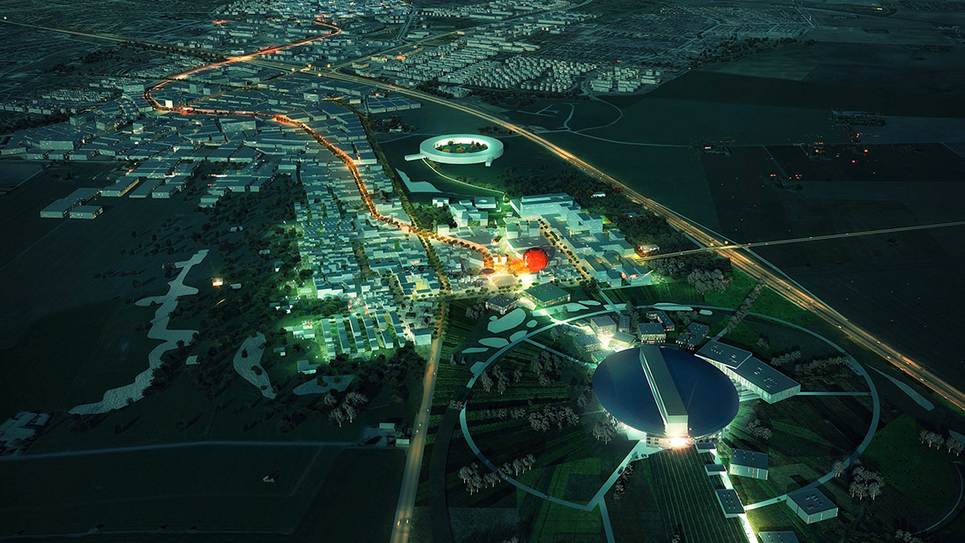
Science Village Scandinavia
Home to two of the most advanced materials science facilities in the world
MAX IV Laboratory
A national research facility
Inaugurated June 2016
Synchrotron source, ”x-ray”
Swedish and international researchers
Budget: Roughly 629m Euro
ESS, European Spallation Source
17 European countries
Sweden and Denmark as hosts
Inauguration 2019, operation 2025
Neutron source, microscope
Researchers mainly international
Budget: 1.84 billion EUR
Photo: COBE
Notes:
Linking both Max IV and ESS and currently under development is Science Village, which forms part of the new city district. The land covers 18 hectares planned for approximately 250,000 m² GFA intended businesses, research and educational facilities in the field of materials research and innovation. University and university college campuses, guest accommodation, research institutes, services, gyms, restaurants and cafés will be built on the plot. The buildings can be erected with up to seven or eight floors, in a variety of architectural styles.
It will develop into a dynamic and sustainable city district that not only accommodates world class research but also serves as a platform for society to play a role in the changes going on as a result of ESS and MAX IV.
Credit: COBE

Slide 20
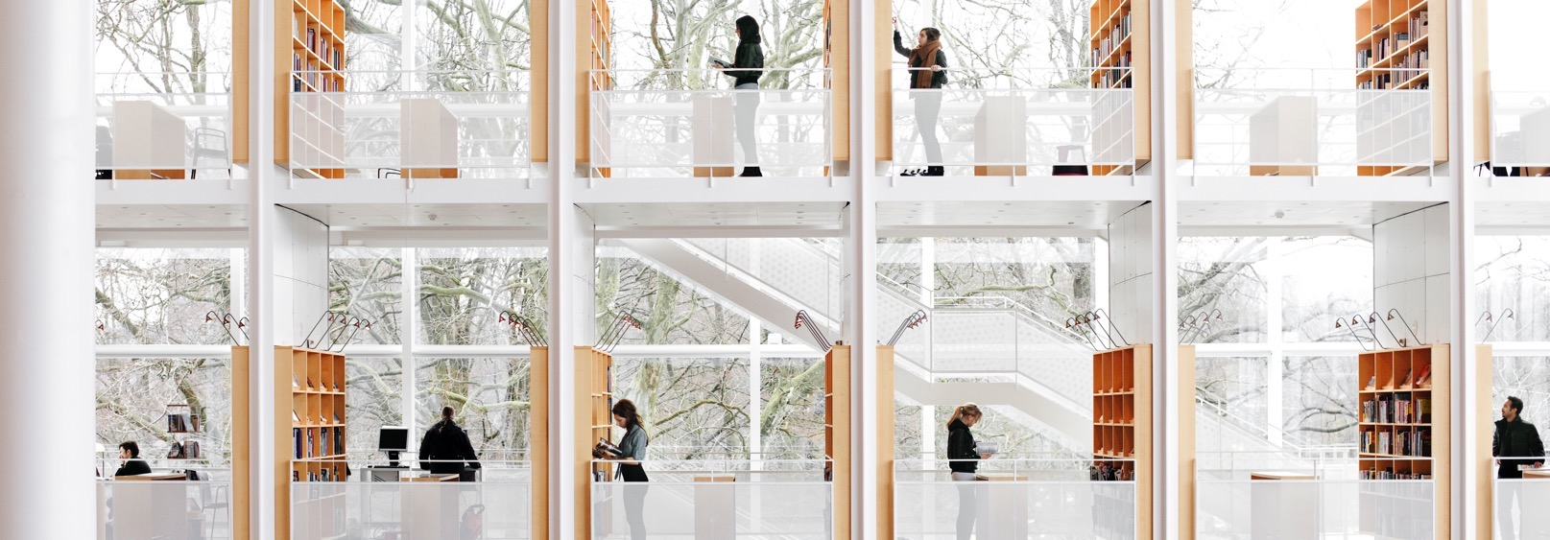
Access to highly skilled people
Skåne belongs to one of Europe’s most expansive knowledge-based economies and offers a large pool of young, international, well-educated people with high technical proficiency. Therefore, several skill-focused industries have been able to grow in the area.
One example is the game industry where Skåne is home to more than 1200 game developers.
Notes:
Benefitting from its strategic location in the gateway between Scandinavia and Northern Europe, Skåne belongs to one of Europe’s most expansive knowledge-based economies and offers an impressive pool of well-educated talent.
It’s part of the Greater Copenhagen region, which is home to 17 different universities, including Skåne’s own Lund University – the highest ranking academic institution in Sweden and among the top 100 universities in the world.
Several skill-focused industries that require different levels of education have thus flourished in the area. Currently, it’s estimated that more than 50 000 locals work within life sciences and over 60,000 are active in information technology with 10,000 of those working within connectivity, digitalisation, and data.

Slide 21
Quote
” I would say the competency available in the area was the top reason for starting up here. The amount of people working in embedded software solutions, connectivity, [and] software security was a reason for choosing Lund for this location”
Carl Gustavsson,​ Deputy Site Manager, Bosch​

Slide 22

A collaborative ecosystem
Thanks to its quadruple-helix approach of strong academic foundation and a cross-sector collaboration between academia, industry, government, and civil society, Skåne consistently sets the stage for world-class research results that offer breakthroughs in everything from cleantech to life sciences.
Notes:
Skåne is within one of the most knowledge-intensive areas in all of the Nordic countries. That extensive expertise is harnessed for collaboration via Sweden’s fostering of the quadruple helix model of innovation in public policy, which creates touch points between academia, industry, government, and civil society, thus enabling for efficient economic and social development.
Thanks to its quadruple-helix approach of strong academic foundation and a cross-sector collaboration, Skåne consistently sets the stage for world-class research results that offer breakthroughs in everything from cleantech to life sciences.

Slide 23
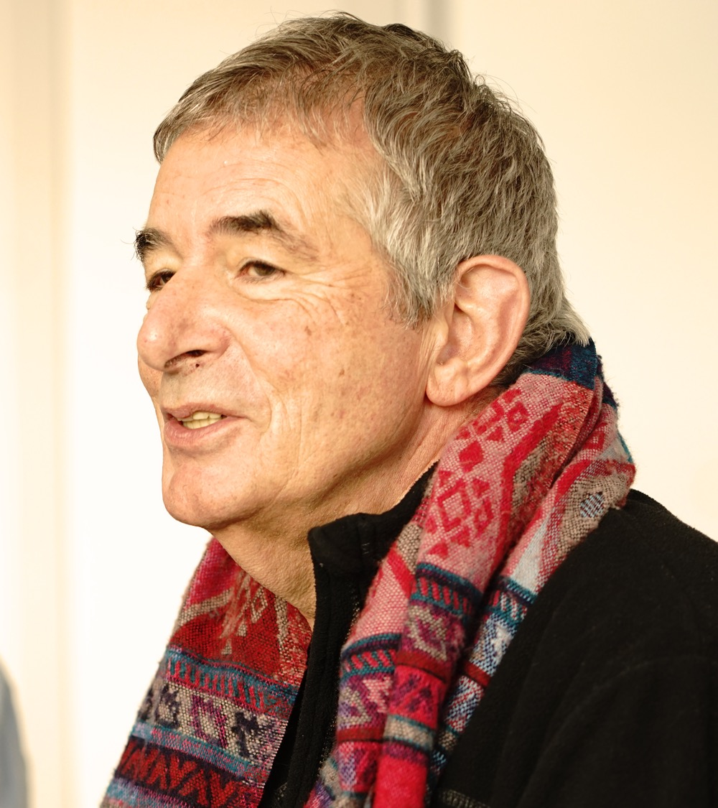
Quote
“People simply like facilitating joint success, rather than getting the upper hand. We like that business we have done has not been on crude, testosterone-led negotiations, but with a real feeling of working cooperatively.”
Tadhg Ó Séaghdha, co-founder and Head of Behavioural Psychology and Psychotherapy of NISAD, established in Lund in 2019.

Slide 24

Exceptional quality of life
Besides having a fantastic infrastructure for international business, Skåne offers beautiful countryside and the chance to enjoy a high quality of life. It is often just a 15 minute journey from the city centres to the unspoilt countryside and some of the world’s finest sandy beaches.
Notes:
Where in Europe can you commute from a demanding job in an international city to your home in a quiet suburb in just 15 minutes by bicycle? In cities like Malmö, Lund and Helsingborg, such quality of life and convenience is normal. Skåne is fairly small and you can easily reach each corner of the region within an hour.
Source (beaches): Blå Flagg

Slide 25

Work-life balance
Photo: Apelöga
Notes:
Employers and employees alike put high value on work-life balance. Generous state-funded parental allowances, subsidised childcare and high-quality state schooling all play their part in making the region a great place to bring up children.
Crime is low by international standards and a 21st century transport network provides ease of movement. From Skåne, the city attractions of Copenhagen are just a quick train or car ride across the Öresund Bridge. Copenhagen International Airport puts a wide assortment of other destinations within easy reach.
The unique combination of plurality, a stimulating business environment and high quality of life means you really can enjoy the best of all worlds in Skåne.

Slide 26
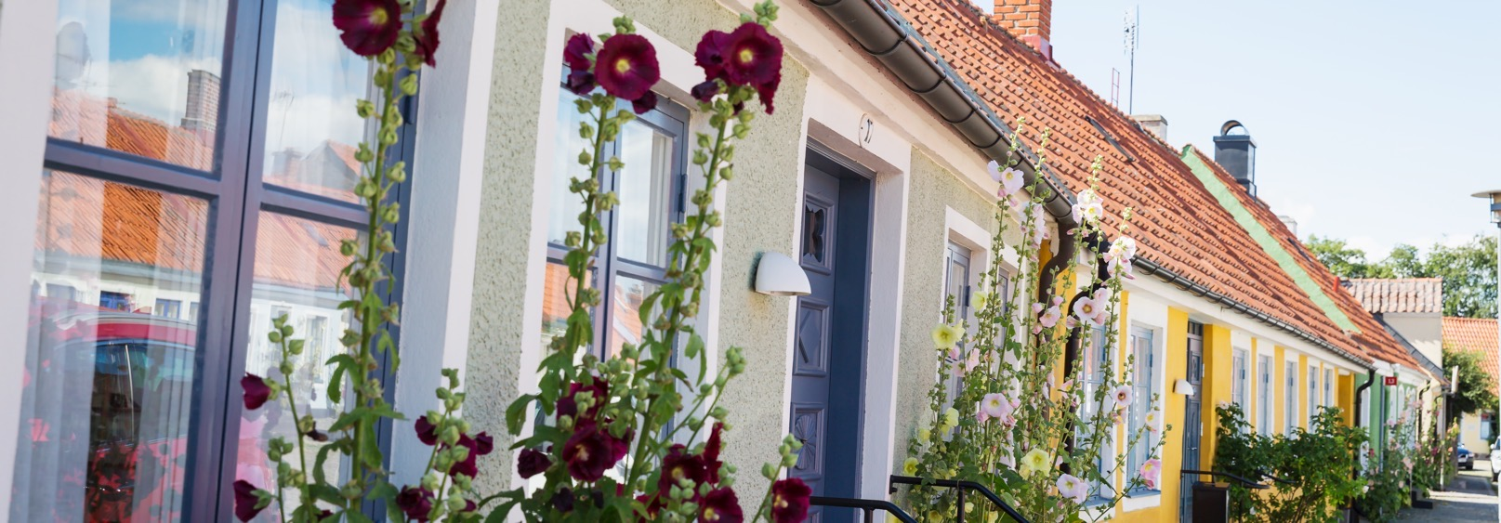
Skåne’s cities and municipalities
33 municipalities
The area is approximately 11000 km²
Malmö, Lund and Helsingborg are the three main cities
Notes:
There are 33 municipalities in Skåne
The area is approximately 11000 km²
The 3 main cities are Malmö, Lund and Helsingborg

Slide 27
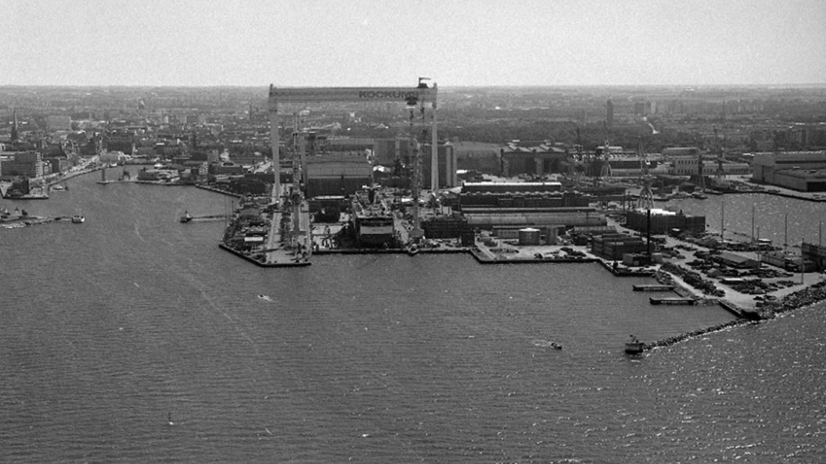
Malmö – from industrial city to a vibrant commercial centre
MALMÖ
Notes:
Skåne’s largest city is Malmö, which is also the third largest city in Sweden. It evolved from an industrial –and rather dormant- city to the vibrant city it is today. Here’s a picture of Malmö as it looked in 1980. Kockums Shipyard was one of the world’s largest shipyards, and its crane (also the largest in the world) was the city’s best known landmark.

Slide 28
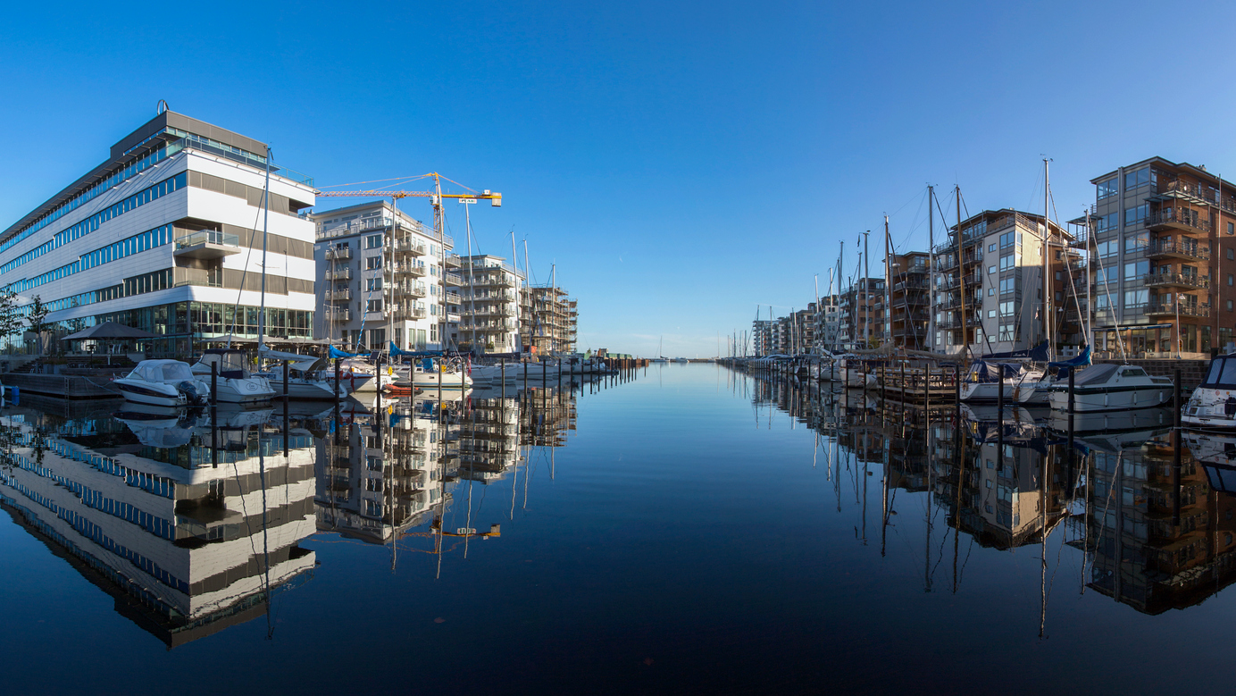
The dry dock today
Photo: Joakim Lloyd Rabeoff
Notes:
Here is the dry dock today and the crane has been replaced by another landmark - Turning Torso –that you can see in the background.
The number of people employed here now is higher than in the peak days of Kockums Shipyard. It’s easy to see that the city has undergone a major transformation with architectural developments, and attracts biotech and IT companies, and particularly students through Malmö University, founded in 1998. Together with Lund, Malmö is the region’s economic and educational hub.

Slide 29
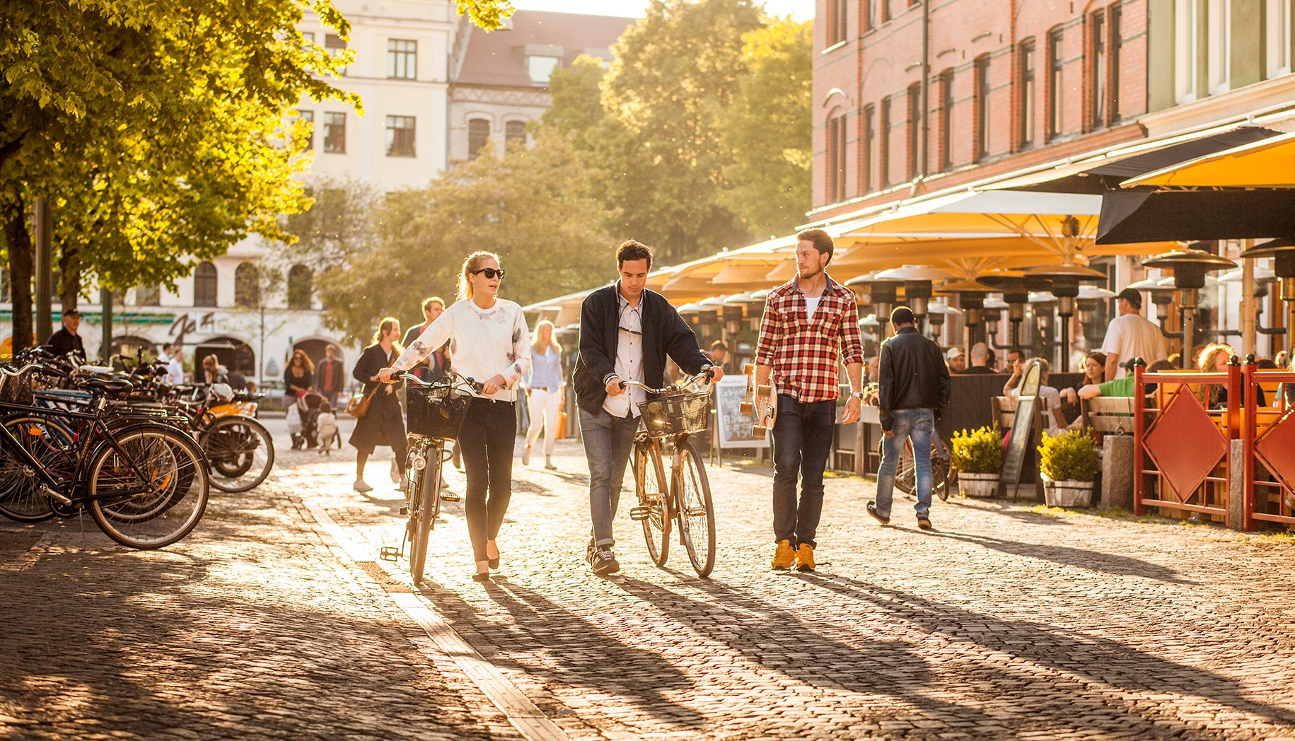
Malmö – a vibrant city
Photo: Apelöga, Malmö Town Image Bank
Notes:
The city is all about culture, exciting cuisine, innovative architecture and a vibrant social scene.
Nearly half of the population are under 35 and the city can also boast with the highest proportion of foreign born residents then any other city in Sweden, a young, talented and international hub.
The city is also home to a large number of thriving startups and innovative success story companies like Oatly and Orbital Systems, and Malmö has been listed one of Europe's biggest tech hubs in State of European Tech 2020.
Malmö University has more than 24,000 students and about 1,600 employees (academic and administrative), and it is the ninth largest institute of learning in Sweden. Source: Wikipedia
In 2021, Malmö was named the best Swedish student city of the year, an award decided upon by a student body which assessed how Malmö excelled at working with its student environment. Source: Swedish National Union of Students (SFS)
Malmö has been selected as one of the greenest city in the magazine ”Hållbarhet” .
Skåne’s capital has attracted the eye of Travel and Leisure magazine, who called it the “hippest city in Scandinavia” in 2014, Forbes, who ranked it the 4th most inventive city in the world (right behind San Francisco, San Diego, and Eindhoven), and was also considered the number one emerging tech hub in the world.

Slide 30
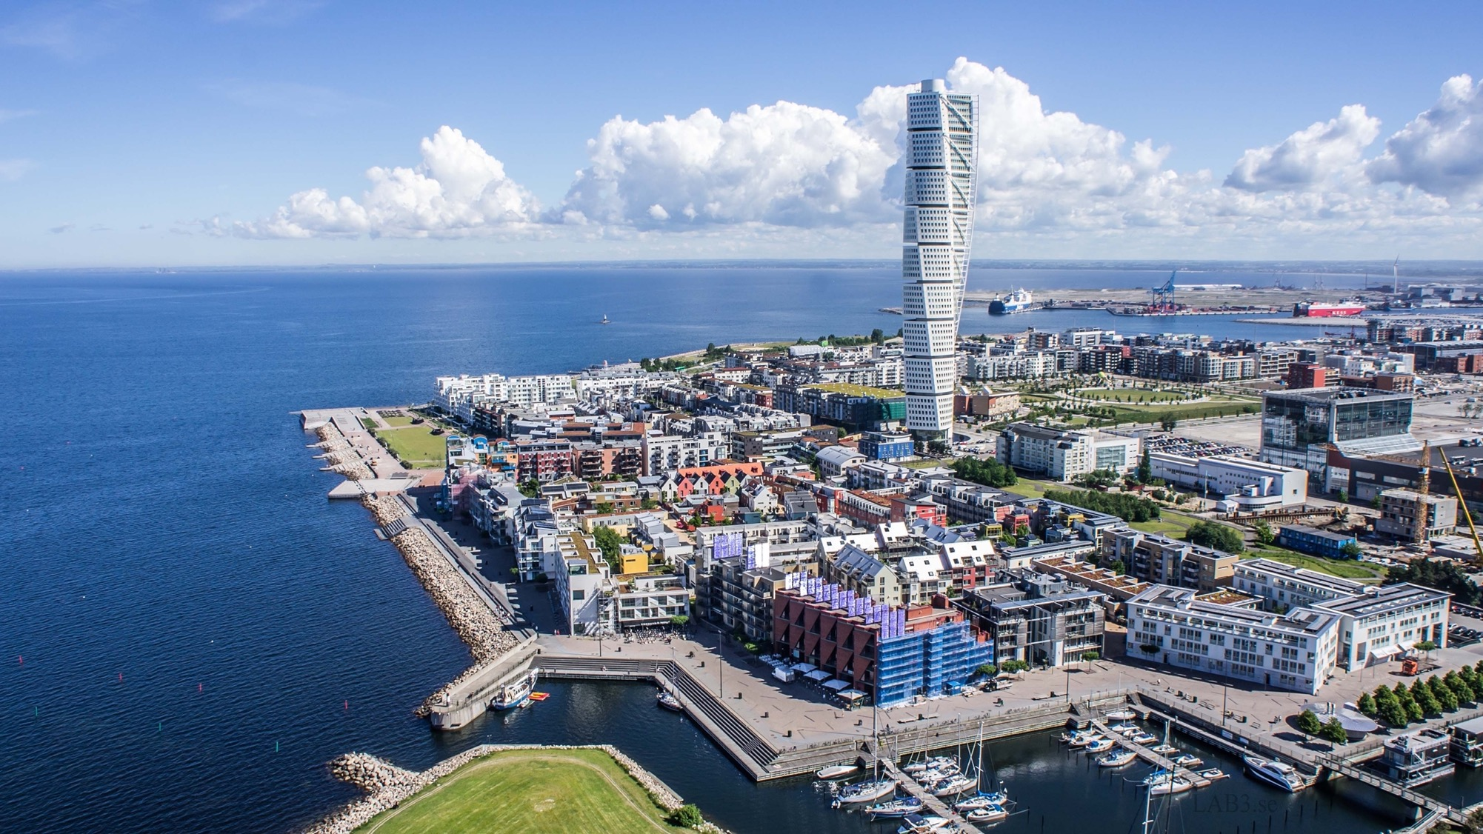
Evolving and sustainable
Notes:
Here is the Western Harbor area of Malmö. As promised, you will also see what is today Malmö’s most iconic landmarks, the Turning Torso. It’s currently the highest building in Scandinavia. Previously an industrial area, the Western Harbor is now an attractive waterfront residential area with boutiques, services and full infrastructure. It’s also regarded as a pioneer when it comes to environmentally sustainable solutions. This is valid for energy, waste handling as well as transport. The area has been designed to use and produce 100 percent locally produced renewable, solar and wind energy.
This was the first area to use a local green space factor to promote biodiversity, incorporating local vegetation, as well as rainwater through open storm water management and connection to the sea. The system was very successful; and since stage two, the green space factor promoting ‘green’ roofs and walls (planted with vegetation) and biodiversity is included in the municipal Environmental Building Code.
An eco-friendly transport system, with busses every five minutes. Bicycle lanes reduced number of parking spaces and car pools were financed by the contractors in the first years. The western harbor is also a test bed for a variety of experiments that promote environmentally more friendly solutions.
Malmö is putting a lot of effort into making the expansion areas of the city sustainable. In southern Malmö the Hyllie area, with 9,000 new homes and workplaces, will be the most climate progressive area in the region – according to the new Climate Contract, signed at the beginning of 2011 by the City of Malmö, the energy company E.ON and the municipal authority VA SYD.

Slide 31
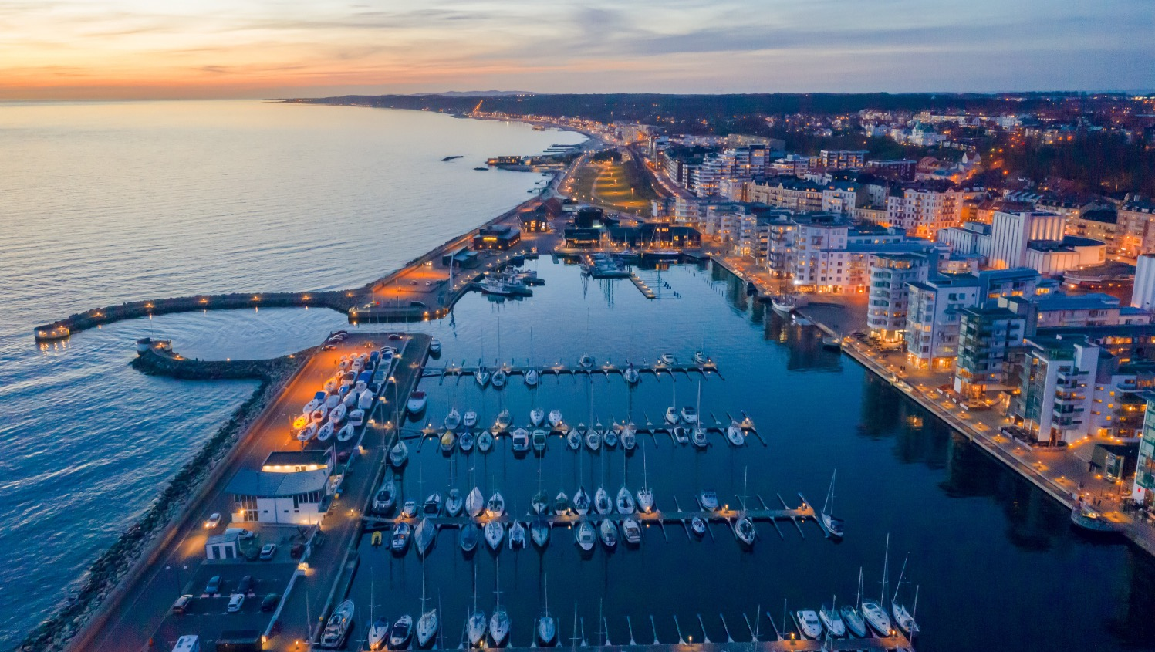
The city of Helsingborg
Photo: City of Helsingborg
Notes:
Helsingborg is the second largest city in Skåne. It also has a coastal location, facing the Danish town of Helsingör. Like Malmö, Helsingborg’s old industrial port has also undergone a transformation into an attractive office and residential area. A new project called H+ which will transform an old harbour area. The project includes the foundations for a tunnel which will eventually connect Helsingborg with Helsingör by road and rail.
Helsingborg came second in the 2020 iCapital award issued by the EU. The award goes to the European city that is best able to demonstrate its ability to harness innovation to improve the lives of its citizens

Slide 32
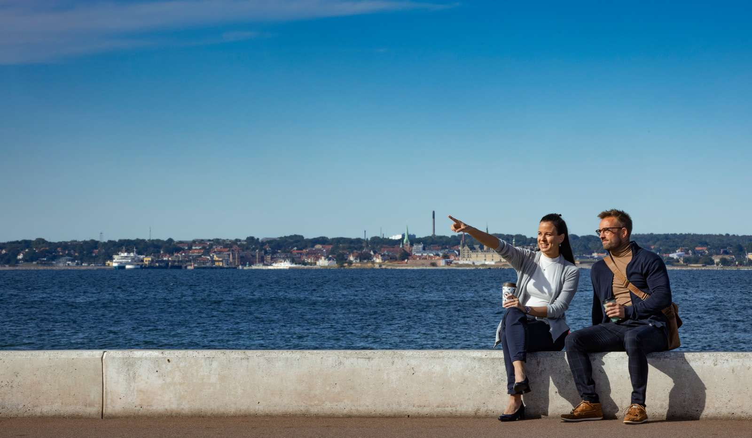

Facts about Helsingborg. Låt vara utanför bild
Photo: City of Helsingborg
Photo: City of Helsingborg

Slide 33
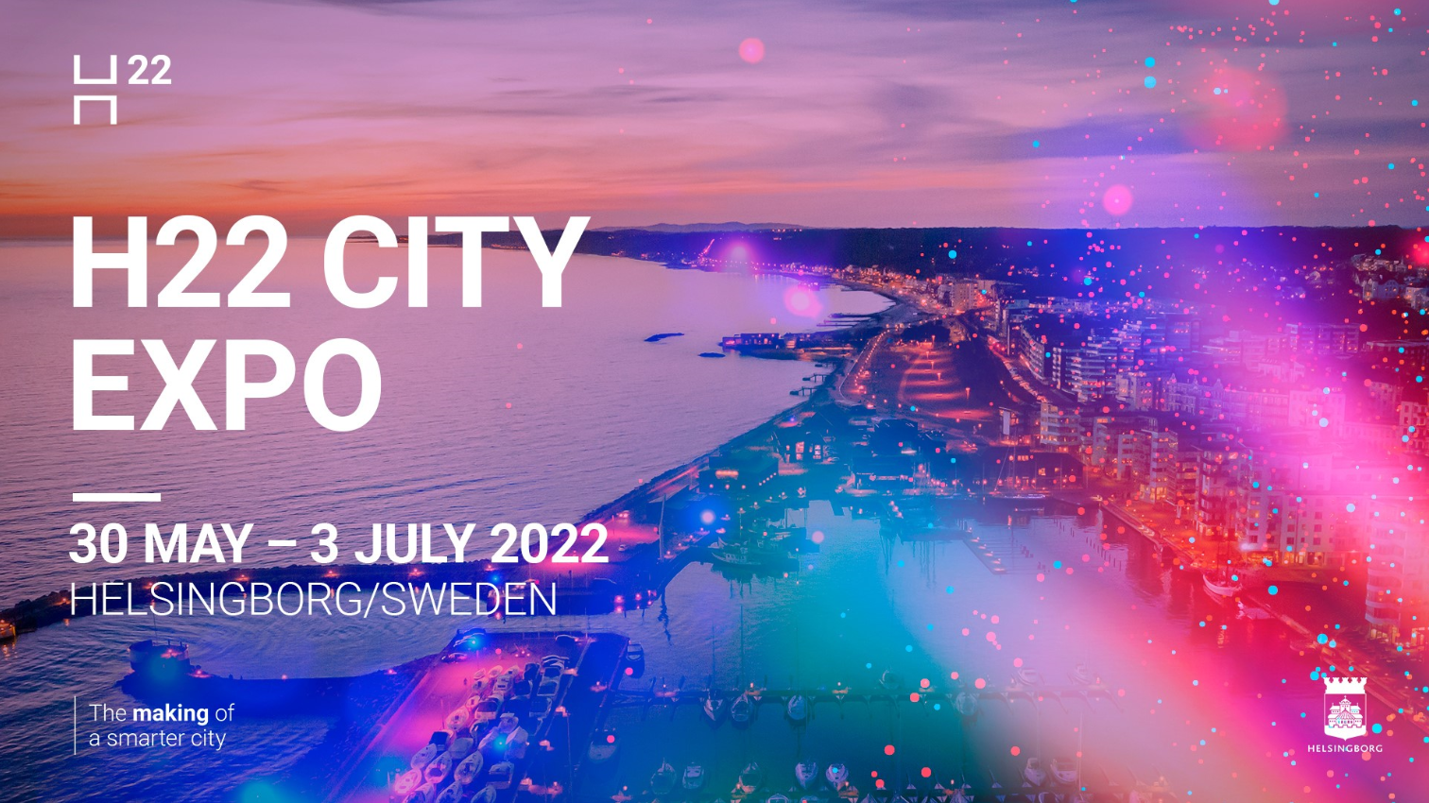
H22 City Expo. Låt ligga utanför bild.
Notes:
H22 is a major initiative by Helsingborg to develop future welfare solutions aimed at improving quality of life in a smarter, more sustainable city.
The city’s work with h22 consists of two parts:
A city-wide innovation initiative. Three themes are guiding the H22 journey towards a sustainable future.
2. A City Expo – From 30 May to 3 July 2022, Helsingborg will play host to the world at H22 City Expo – an international event exploring innovation and sustainability in smart cities. During and after the City Expo, the long-term initiative continues.
Read more on https://h22.se/en/

Slide 34

The city of Lund
12th largest city of Sweden with 124 935 inhabitants in the municipality
The European Spallation Source and MAX IV
Lund University, one of Scandinavia’s largest institutions for education and research
Ideon Science Park – home to over 400 companies
Domkyrkan ”the Dome”, one of the seven wonders of Sweden
Notes:
Lund is another important city in Skåne, mostly known for its University, but also for two of the world’s most advanced research facilities, namely MAX IV and ESS.
The city with approximately 124 935 inhabitants is believed to have been founded around 990 during the period that Skåne belonged to Denmark.
Lund University is one of Scandinavia’s largest institutions for education and research, known for it’s vibrant student life – which includes a Carnival every 4 years.
Lunds domkyrka har fått toppbetyget tre stjärnor av Guide Michelins turistguide Green Guide och har utsetts till ett av Sveriges sju underverk av Vetenskapsradions lyssnare. (Källa: https://lundsdomkyrka.se/lunds-domkyrka-2/)

Slide 35
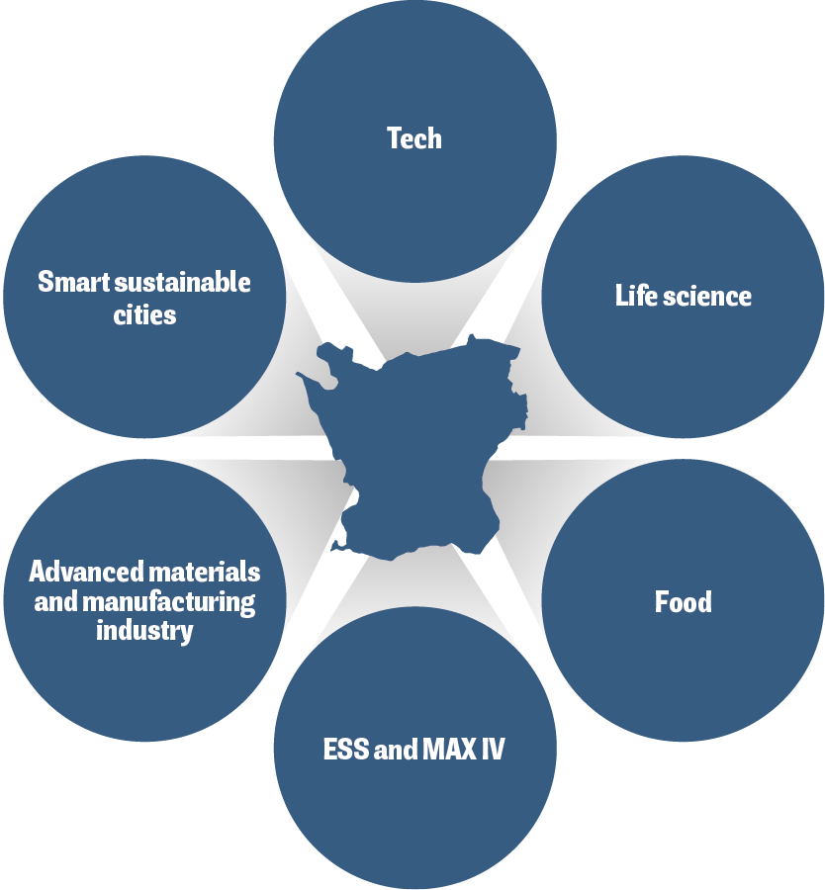
Focus areas in Skåne
Notes:
Skåne hosts a unique research environment in which the private sector, government and academia collaborate closely. An extensive network of research assets unite dynamic sector clusters, science parks, universities and public bodies in a shared ambition to drive innovation and business.
The research and innovation council of Skåne (FIRS) has prioritised six areas of specialisation with growth potential. The main selection criteria for most of the prioritised areas has been the existence of a cluster within the Skåne business environment. An additional one has been whether or not the area has a clear relationship with prominent research fields in the region.

Slide 36
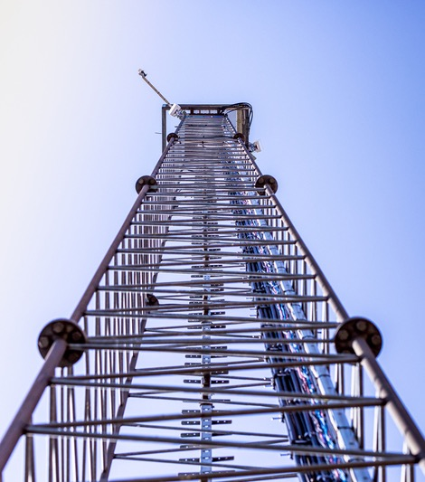
Tech
There is a wide range of tech companies in Skåne; from global leaders to well-known start-up ​
Including successful companies within hardware and network solutions, sensors and Internet of things, but also various forms of digital applications and consulting services​
The region has specifically advanced technical expertise in deep tech which includes Artificial Intelligence, Internet of Things, 5G, image recognition and big data​
A rapidly growing segment is game development​
There are several solid education platforms aimed at producing tech related competence and tech is the most common area for new innovations​
Skåne tech companies are attracting the fourth largest share of investments trailing the Nordic capital cities​
Photo: Apelöga

Slide 37
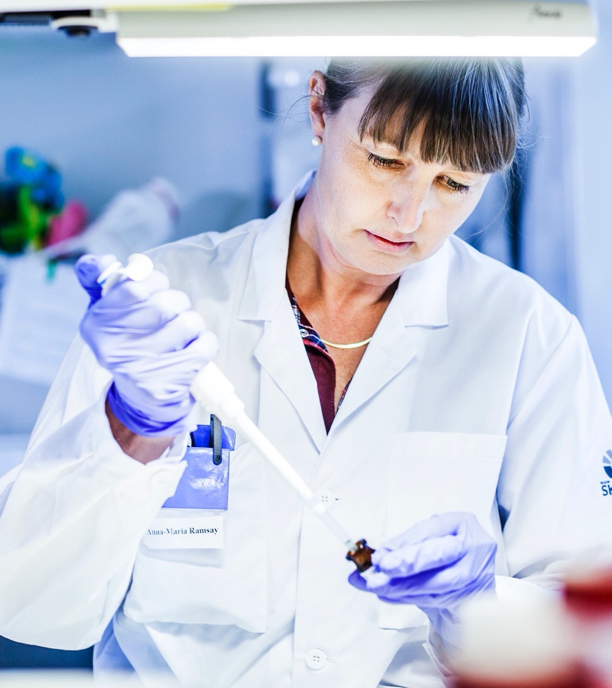
Life science​
The life science sector in Skåne is well-known internationally and accounts for 16 % of the Swedish life science industry​
Skåne is part of Medicon Valley, the strongest life science cluster in the Nordics with over 50,000 employees, making it Northern Europe´s largest labour market in life science​
The life science sector includes companies in the development, production, and distribution of medicines and medical technology, basic research, clinical research, and parts of the healthcare system​
The sector is currently undergoing a change that entails both a new approach to tech and big data, and an increased focus on prevention​
The life science sector in Skåne has a strong academic reputation, with a large number of internationally recognized scientific publications.​
Photo: Apelöga

Slide 38

Food
30% of all food we consume in Sweden comes from Skåne​
The region has strong assets in the entire food system, from primary production, through processing and packaging, to the retail and consumer sector, as well as a well-developed innovation system​
A prominent strength is at the intersection of life science, agronomy, and food research, especially with regard to diabetes and metabolism​
Skåne has a significant start-up scene for new food companies covering the entire spectrum from sustainable fish farming to biodegradable products​
Sweden’s largest incubator with a food profile – Krinova – is situated in Skåne​
Photo: Apelöga

Slide 39
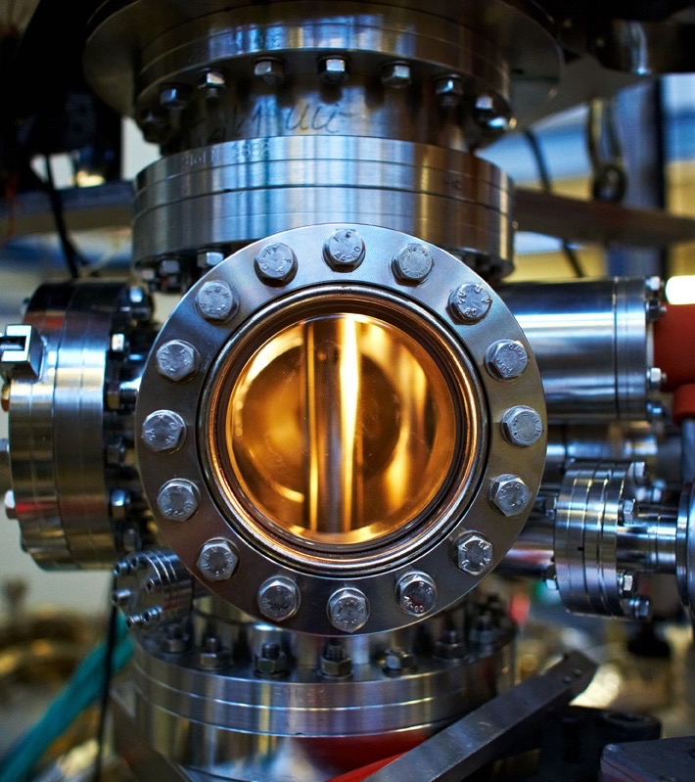
Advanced materials and manufacturing industry
(incl ESS & Max IV)​
The global demand for advanced materials is increasing due to rapid industrialisation and the market is expected to grow at a CAGR of 5.1 %
2018–2024​
Skåne’s advanced materials and manufacturing industry includes several different sub-industries such as packaging, refrigeration and ventilation technology, chemistry, plastics, and rubber​
The manufacturing industry is currently transitioning from unskilled to qualified jobs and many companies are investing in various forms of smart automation and digitalisation​
ESS and MAX IV are two globally renowned research facilities attracting international research and interest, increasing attractiveness, and leading to an influx of skills to the Skåne region​
Max Lab by Lasse Davidsson

Slide 40
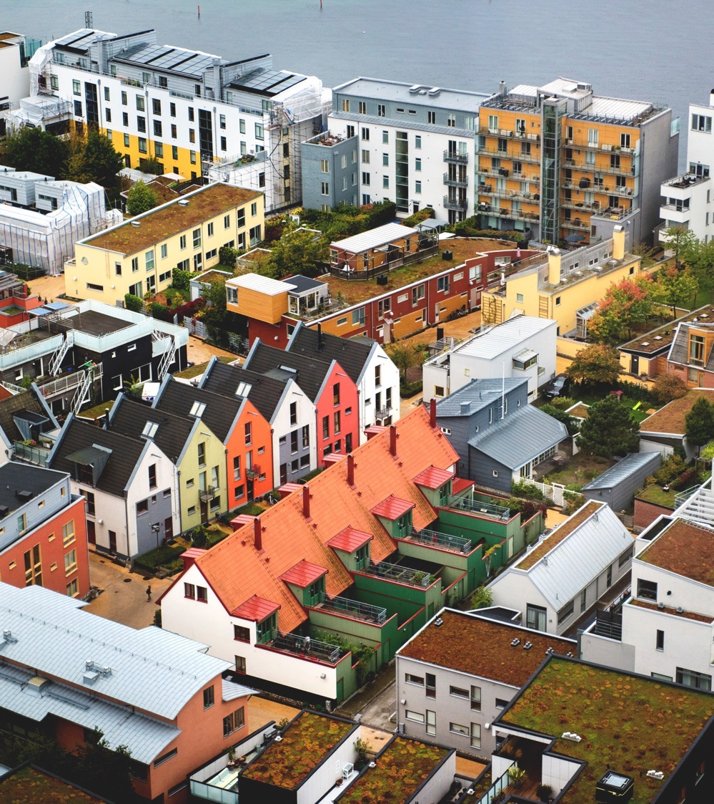
Smart sustainable cities​
In Sweden, 85 % of the population is living in cities which has led to the rapid development and implementation of smart and efficient solutions​
This is a sector in which Skåne’s larger cities have expressed a clear ambition to innovate together with businesses, academia and civil society​
Much of the potential for innovation in the urban environment requires system solutions where the public sector and the business community collaborate, test and scale up​
In Skåne, there are important research strongholds within the areas of climate environment, renewable energy and fuel, the Internet of Things as well as water and recycling​
The Skåne politicians highlight sustainable urban development as a strategically important area for further development​
Western Harbour in Malmö by Aline Lessner, Image Bank Sweden

Slide 41

Let us help you do business in Skåne
@ Apelöga
Invest in Skåne is the official investment promotion organisation for the southernmost part of Sweden. We help international companies invest and expand in the region and attracting valuable talent to the region, securing a skilled, diverse and competent workforce in Skåne, and the Greater Copenhagen region.
Notes:
We are Invest in Skåne, the official trade and investment promotion agency for the southernmost part of Sweden. As a part of Business Region Skåne, our mission is to proactively promote the area to attract international investments and assist local business expanding into international markets.

Slide 42





Invest in Skåne’s services
Investment promotion
Establishment services
Market and industry opportunities
Innovation and talent scouting
Expansion services
Investment opportunities
Site selection
Notes:
Establishment services
Get hands-on supprt in business registration
Get informations about visiting programs
Get knowledge about local regulations
Market and industry opportunities
We provide customised industry data
Information about the latest market and industry opportunities
Get benchmarking analyses
Innovation and talent scouting
Find cutting-edge startup companies in Skåne
Right local talent your company needs
Site selection
Explore the Skåne region’s infrastructure
Get access to detailed data
Get guidance with the site selectionn process
Assistance in coordinating visiting programs
Expansion services
For already established business
Recieve customised suppor to expand your presence in the region

Slide 43
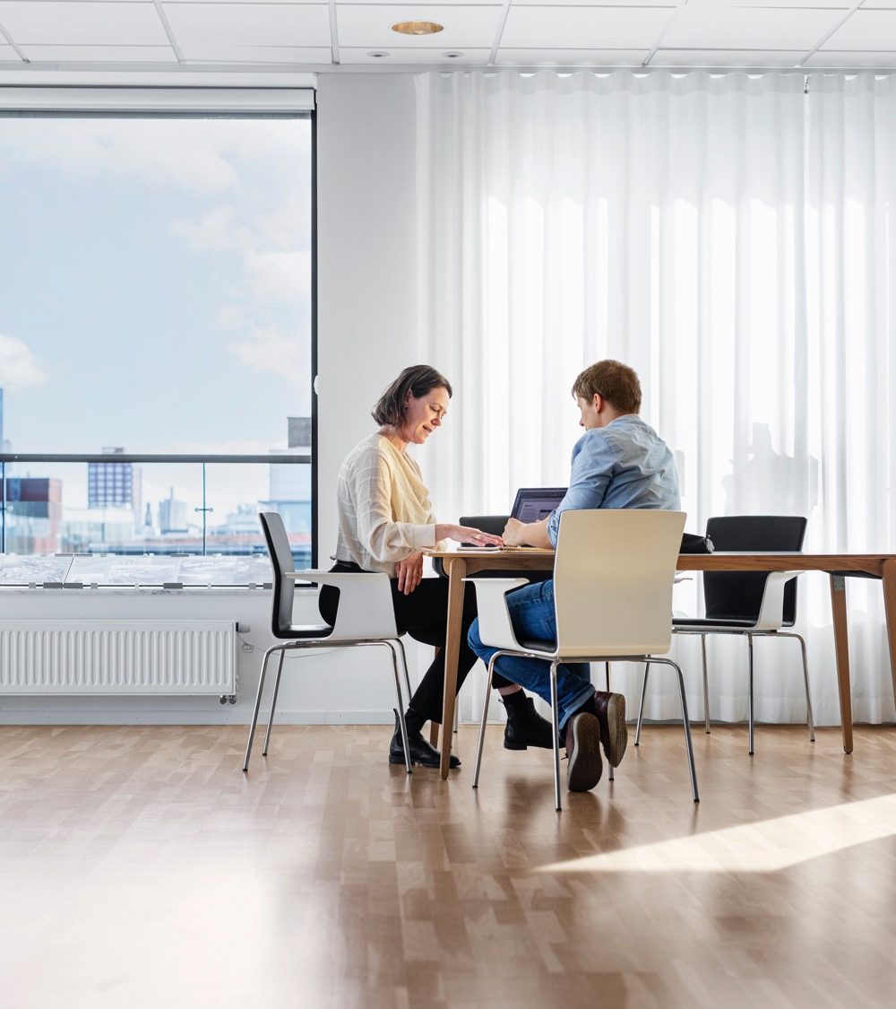




Connect with us!
If you want to invest or do business in Skåne, please visit www.investinskane.com or contact us for more information.
Linkedin
Facebook
Twitter
Youtube
Photo: Apelöga

